Slide 1
Topic: Regime Prediction using Machine Learning in Stock Market
REVA Academy for Corporate Excellence (RACE)
Date:3/7/2022
Name of the Presenter(s)
Anand Mohan
Batch:MBA06
Trimester: FIFTH TRIMESTER
SRN: R19MBA53
www.race.reva.edu.in

Slide 2

Background Information
Majority of share market investment decisions are highly influenced by herd mentality.

Slide 3
Background Information
Making investments in Asset classes
In some industries, data not easily available . Need to put in extra efforts to find and evaluate data. Make wiser decisions accordingly.
Balance sheets can be manipulated by the management. Do ample research and then invest.

Slide 4

Background Information
Even though we may be committed to sticking with our investing strategy, need to check periodically .
In-depth review of our Asset portfolios on a quarterly basis. most advisors recommend at least an annual check in.
share market doesn't behave consistently at all times, identifying right time to invest...most beneficial.
Buying the identified Assets at the lowest price level will increase the potential profits investors can earn. Moreover, selling the Assets when it is trading at the highest price is profitable.

Slide 5
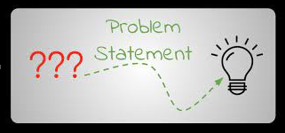

Statement of the Problem
whether the market is bull or bear is not just the market's knee-jerk reaction to a particular event, but how it is performing over the long term.
Small movements only represent a short-term trend or a market correction.
Whether or not there is going to be a bull market or a bear market can only be determined over a longer time period.
Investor psychology and sentiment affect whether the market will rise or fall.
stock market and the economy are strongly linked.
Based on these known factors, Market analysts come up with their fundamental Analysis with some key Market ratios and Technical indicators. This has been already done earlier which roughly give an estimate of the Bullish and Bearish Regimes.

Slide 6

Statement of the Problem
Requirement comes for us to be able to estimate and benchmark our
accuracies in able to predict Bullish and Bearish regimes by using the
Asset class returns as Independent variables and able to predict Regimes
period (Bullish or Bearish) to identify Recession periods spot on.
My major milestone targets would be trying simpler and easy to
understand solutions which can get most effortlessly applied by any
non-professional investor and which still helps them to optimize their
portfolios decisions based on Bullish and Bearish Regimes.

Slide 7
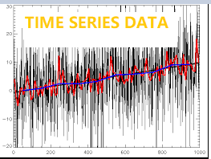
Proposed Solution
We will employ different Modeling algorithms on the transformed data which mainly comprises of Returns values for different Asset classes.
We will be using Regime as Target or Dependent Variable to predict bullish or bearish Regimes AND TO IDENTIFY ZONES OF RECESSION.
Assumptions of Time series Model are that Data should be stationary.
We will convert the features into stationary form by applying the necessary transformations namely Differencing and Log transformation.
The Idea is to convert non stationary data to stationary data to do better forecasting.

Slide 8
Proposed Solution
Initially we will apply Logistic Regression Classifier by tuning hyper parameters such as Logistic Regression with no penalty, L1 penalty, and L2 penalty.
We will also be tuning hyper parameter Inverse regularization parameter C differently in Logistic Regression. Regularization is applying a penalty to increasing the magnitude of parameter values in order to reduce over fitting.
Then we will apply Nonlinear Classifier Models namely Decision Tree Classifier Modelling, Random Forest Classifier Modelling and XGBoost Classifier Modeling.These Modelling algorithms will be applied several times by tuning their hyper parameters differently.
We will use 4 different Evaluation Metrics namely classification accuracy (ACC), quadratic probability score (QPS), Matthew's Correlation Coefficient (MCC) and Area under the ROC curve to determine the quality of predicted outputs.
We will be applying Cross-Validation Technique and Rolling-Window Technique while Building prediction Models.

Slide 9
Detailed Scope of Work:
Assumptions of Time series Model are that Data should be stationary.
Non stationary data may show the trend. But we should convert non stationary data to stationary data to do better forecasting.
We will convert the features into stationary form by applying the necessary transformations namely Differencing and Log transformation. Then we will Add 1, 3, 6,9,12 months lags of the features.
Then we will be employing different Modelling algorithms on the transformed data.
We will be using Regime as Target or Dependent Variable to predict bullish or bearish Regimes.

Slide 10

Detailed Scope of Work:
FRED is an online database which provides me the actual returns data for the Asset classes.
It also provided Regime_index1.
The index is a benchmark market index that represents the weighted average of all the Asset classes’ returns. Based on Index trend, Bullish or Bearish Regime is determined.
Based on Bullish or Bearish trends, Regime_index1 marks the Bullish Regime as 0 and Bearish period as 1.
Similarly Regime_index2, Regime_index3, Regime_index4, Regime_index5 is obtained.

Slide 11
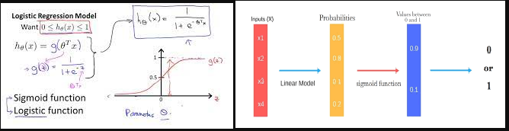
Detailed Scope of Work:
Logistic Regression modelling

Slide 12
Detailed Scope of Work:
Logistic Regression modelling
We will be using Logistic Regression modeling several times by tuning hyper parameters differently by varying hyper parameter penalty as None, l1 and l2 and also modifying Inverse regularization parameter C differently as 0.0001, 0.01, 0.1, 1, 10 and 100.
For the Logistic Regression Modeling we will also be defining the hyper parameters solver as 'saga'and max_iter as 100.
Then we will be determining the best solution possible by choosing the best Machine Learning Model from each of the 3 different types of Models built via Logistic Regression modelling namely the one with Hyper parameter penalty tuned as Null, The second one with Hyper parameter penalty tuned as L1, and the third one with Hyper parameter penalty tuned as L2.
We will be using 4 different Evaluation Metrics to choose the best Prediction Models. Those Evaluation Metrics will be classification accuracy (ACC), quadratic probability score (QPS), Matthew's Correlation Coefficient (MCC) and Area under the ROC curve.

Slide 13
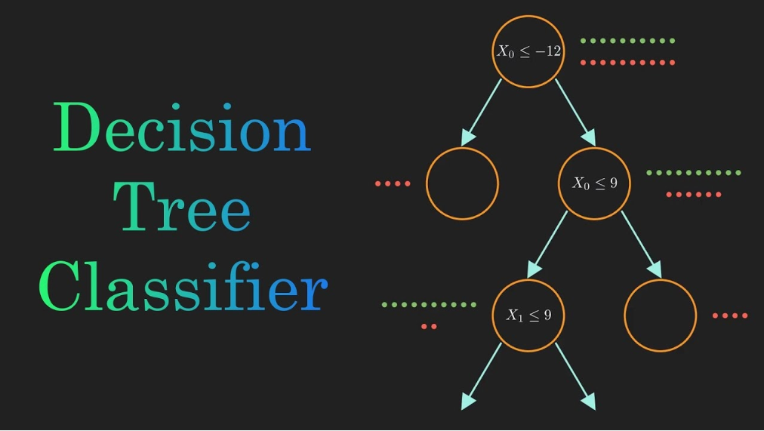
Detailed Scope of Work:
Decision Tree
Classifier modelling

Slide 14
Detailed Scope of Work:
Decision Tree
Classifier modelling
Decision trees use multiple algorithms to decide to split a node into two or more sub-nodes. The creation of sub-nodes increases the homogeneity of resultant sub-nodes.
In other words, we can say that the purity of the node increases with respect to the target variable. The decision tree splits the nodes on all available variables and then selects the split which results in most homogeneous sub-nodes.
It begins with the original set S as the root node. On each iteration of the algorithm, it iterates through the very unused attribute of the set S and calculates Entropy(H) and Information gain(IG) of this attribute.
It then selects the attribute which has the smallest Entropy or Largest Information gain.
The set S is then split by the selected attribute to produce a subset of the data.
The algorithm continues to recur on each subset, considering only attributes never selected before.

Slide 15
Detailed Scope of Work:
Decision Tree
Classifier modelling
Entropy is a measure of the randomness in the information being processed. The higher the entropy, the harder it is to draw any conclusions from that information.
Information gain or IG is a statistical property that measures how well a given attribute separates the training examples according to their target classification.
Constructing a decision tree is all about finding an attribute that returns the highest information gain and the smallest entropy.
We will be using Decision Tree Classifier Modeling several times by tuning hyper parameters differently such as max_depth as 3, 5, 8, 10,splitter as best and random,min_samples_split as 2, 3 and 5.
We will be using 4 different Evaluation Metrics to choose the best Prediction Model from several instances of Decision Tree models constructed by tuning hyper parameters differently. Those Evaluation Metrics will be classification accuracy (ACC), quadratic probability score (QPS), Matthew's Correlation Coefficient (MCC) and Area under the ROC curve.

Slide 16
Detailed Scope of Work:
Decision Tree
Classifier modelling
Decision trees use multiple algorithms to decide to split a node into two or more sub-nodes. The creation of sub-nodes increases the homogeneity of resultant sub-nodes.
In other words, we can say that the purity of the node increases with respect to the target variable. The decision tree splits the nodes on all available variables and then selects the split which results in most homogeneous sub-nodes.
It begins with the original set S as the root node. On each iteration of the algorithm, it iterates through the very unused attribute of the set S and calculates Entropy(H) and Information gain(IG) of this attribute.
It then selects the attribute which has the smallest Entropy or Largest Information gain.
The set S is then split by the selected attribute to produce a subset of the data.
The algorithm continues to recur on each subset, considering only attributes never selected before.

Slide 17
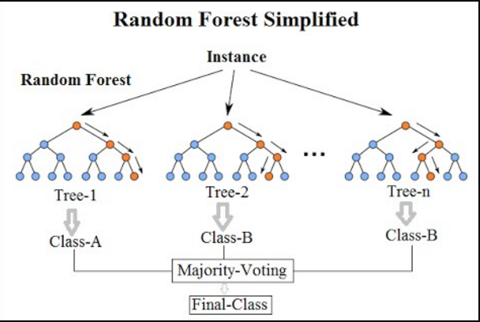
Detailed Scope of Work:
Random Forest Classifier modelling

Slide 18
Detailed Scope of Work:
Random Forest Classifier modelling
Random Forest is based on the concept of ensemble learning, which is a process of combining multiple classifiers to solve a complex problem and to improve the performance of the model.
Random Forest is a classifier that contains a number of decision trees on various subsets of the given dataset and takes the average to improve the predictive accuracy of that dataset. Instead of relying on one decision tree, the random forest takes the prediction from each tree and based on the majority votes of predictions, and it predicts the final output. The greater number of trees in the forest leads to higher accuracy and prevents the problem of over fitting.
We will be using Random Forest Classifier Modelling several times by tuning its hyper parameters differently such as random_state as 42, max_depth as 3, 5, 8 and 10,n_estimators as 100,200 and 400.
We will be using 4 different Evaluation Metrics to choose the best Prediction Model from several instances of Random Forest models constructed by tuning hyper parameters differently. Those Evaluation Metrics will be classification accuracy (ACC), quadratic probability score (QPS), Matthew's Correlation Coefficient (MCC) and Area under the ROC curve.

Slide 19
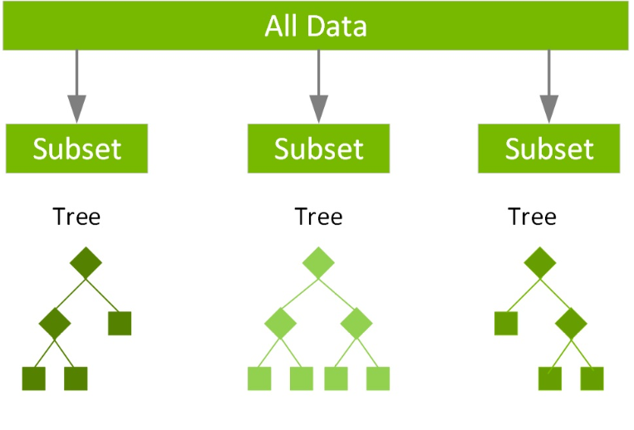
Detailed Scope of Work:
XG Boost
Classifier modelling

Slide 20
Detailed Scope of Work:
A Gradient Boosting Decision Trees (GBDT) is a decision tree ensemble learning algorithm similar to random forest, for classification and regression.
Ensemble learning algorithms combine multiple machine learning algorithms to obtain a better model.
Both random forest and GBDT build a model consisting of multiple decision trees. The difference is in how the trees are built and combined.
Random forest uses a technique called bagging to build full decision trees in parallel from random bootstrap samples of the data set. The final prediction is an average of all of the decision tree predictions.

Slide 21
Detailed Scope of Work:
XG Boost Classifier modelling
Gradient boosting is an extension of boosting where the process of additively generating weak models is formalized as a gradient descent algorithm over an objective function. Gradient boosting sets targeted outcomes for the next model in an effort to minimize errors. Targeted outcomes for each case are based on the gradient of the error (hence the name gradient boosting) with respect to the prediction.
XGBoost is a scalable and highly accurate implementation of gradient boosting that pushes the limits of computing power for boosted tree algorithms, being built largely for energizing machine learning model performance and computational speed.
We will then also be using XGBoost Classifier Modelling several times by tuning its hyper parameters differently such as booster as gbtree,max_depth as 3, 5, 8 and 10,n_estimators as 100,200 and 400,random_state as 42,objective as binary: logistic.
We will be using 4 different Evaluation Metrics to choose the best Prediction Model from several instances of XG Boost models constructed by tuning hyper parameters differently. Those Evaluation Metrics will be classification accuracy (ACC), quadratic probability score (QPS), Matthew's Correlation Coefficient (MCC) and Area under the ROC curve.

Slide 22
Detailed Scope of Work:
Evaluation Metrics
The model outputs are received in two forms: probability forecasts and binary classification of regime states. We consider multiple error metrics to evaluate a classification model performance. A natural metric is classification accuracy (ACC).
Quadratic probability score (QPS) evaluates prediction performance in terms of probabilities. QPS does not evaluate classification ability. If two models have different probability outputs, they might have same ACC score but not same QPS which is mean squared error of probability forecasts. In a perfect prediction setting, QPS equals 0. The lower the value of QPS, the better is the model performance.
The Matthew's Correlation Coefficient (MCC) is also reported as an evaluation metric and deployed widely in the field of computational biology. In perfect prediction setting MCC equals 1 and the worst value is -1. Therefore the higher the MCC score the better the classification performance.
Receiver operating characteristic (ROC) curve is a common choice in imbalanced classification problems. ROC curve plots true positive rate against false positive rate at various threshold settings. Area under the ROC curve (AUC) generates summary statistic for ROC metric. Higher the AUC value, the better is the model performance.

Slide 23
Detailed Scope of Work:
Cross-Validation and Rolling-Window Technique
We will be applying Cross-Validation Technique and Rolling-Window Technique while Building prediction Models.
Cross-validation is a common framework for hyper parameter tuning in the ML field. In the standard k-fold framework, training data is randomly grouped into k folds.
In each iteration, model is trained on k-1 folds, and the remaining fold is used for validation. After k iteration, average of the model score is computed from validation sets.
Since our dataset has a time series property, we implement the cross-validation to keep temporal dependency and avoid look ahead bias.
We create 𝑘 -folds as block of time periods, and move training and validation sets in a rolling basis. After the model hyper parameter optimization, out-of-sample predictions are performed in a rolling window basis with a length of 150 months.

Slide 24
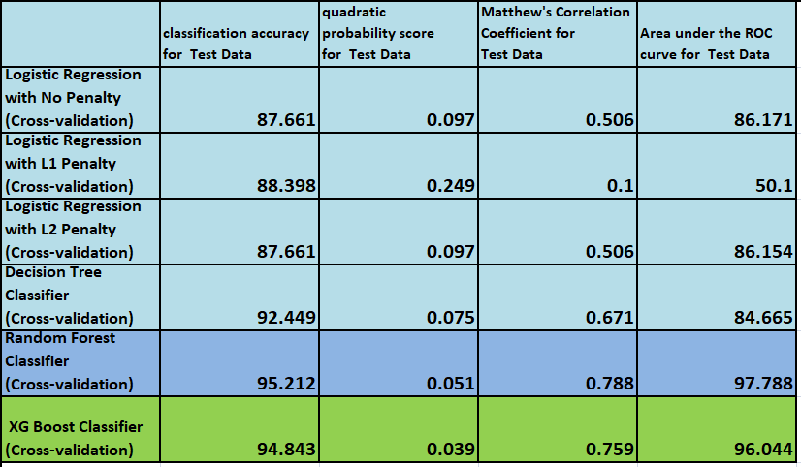
Detailed Scope of Work:
Leader Board for comparison of Evaluation Metrics

Slide 25
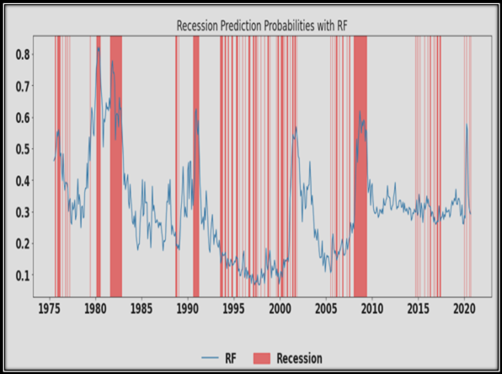
Detailed Scope of Work:
Sample Dashboard Defining Zones of Recession
and Bullish/Bearish Regimes

Slide 26
References:
[1] Arturo Estrella and Frederic S. Mishkin , PREDICTING U.S. RECESSIONS: FINANCIAL VARIABLES AS LEADING INDICATORS
[2] Periklis Gogas ,Dionisios Chionis, Ioannis Pragkidis(March 2009), Predicting European Union recessions in the euro era- Democritus University of Thrace
[3] Serena Ng,Department of Economics, Columbia University,Viewpoint: Boosting Recessions
[4] Melody Y. Huang, Randall R. Rojas, Patrick D. Convery, Department of Economics,University of California, Los Angeles(May 30, 2018),News Sentiment as Leading Indicators for Recessions
[5] Olivier Jean Blanchard and Stanley Fischer(March 10-11, 1989),NBER Macroeconomics Annual 1989, Volume 4
[6] Ruslan Bikbov and Mikhail Chernov(November 11, 2008),Monetary Policy Regimes and The Term Structure of Interest Rates
[7] Burak Saltoglu,M. Ege Yazgan(November 2012),The Role of Regime Shifts in the Term Structure of Interest Rates: Further Evidence from an Emerging Market
[8] Jonathan H. Wright(2006-07),The Yield Curve and Predicting Recessions
[9] Trevor Hastie, Robert Tibshirani,Jerome Friedman,The Elements of Statistical Learning

Slide 27


